Slide 1
Management History
Management
Stephen P. Robbins Mary Coulter
tenth edition
Chapter
2

Slide 2
Learning Outcomes
Follow this Learning Outline as you read and study this chapter.
2.1 Historical Background Of Management.
  Explain why studying management history is important.
  Describe some early evidences of management practice.
  Describe two important historical events that are significant to the study of management.
2.2 Classical Approach.
  Describe the important contributions made by Frederick W. Taylor and Frank and Lillian Gilbreth.
  Discuss Fayol’s and Weber’s contributions to management theory.
  Explain how today’s managers use scientific management and general administrative theory.

Slide 3
Learning Outcomes
2.3 Quantitative Approach.
  Explain what the quantitative approach has contributed to the field of management.
  Describe total quality management.
  Discuss how today’s managers use the quantitative approach.
2.4 Behavioral approach.
  • Describe the contributions of the early advocates of OB.
  • Explain the contributions of the Hawthorne Studies to the field of management.
  • Discuss how today’s managers use the behavioral approach.

Slide 4
Learning Outcomes
2.5 Contemporary Approach
  Describe an organization using the systems approach.
  Discuss how the systems approach helps us understand management.
  Explain how the contingency approach is appropriate for studying management.

Slide 5
Historical Background of Management
Ancient Management
  Egypt (pyramids) and China (Great Wall)
  Venetians (floating warship assembly lines)
Adam Smith
  Published The Wealth of Nations in 1776
    Advocated the division of labor (job specialization) to increase the productivity of workers
Industrial Revolution
  Substituted machine power for human labor
  Created large organizations in need of management

Slide 6
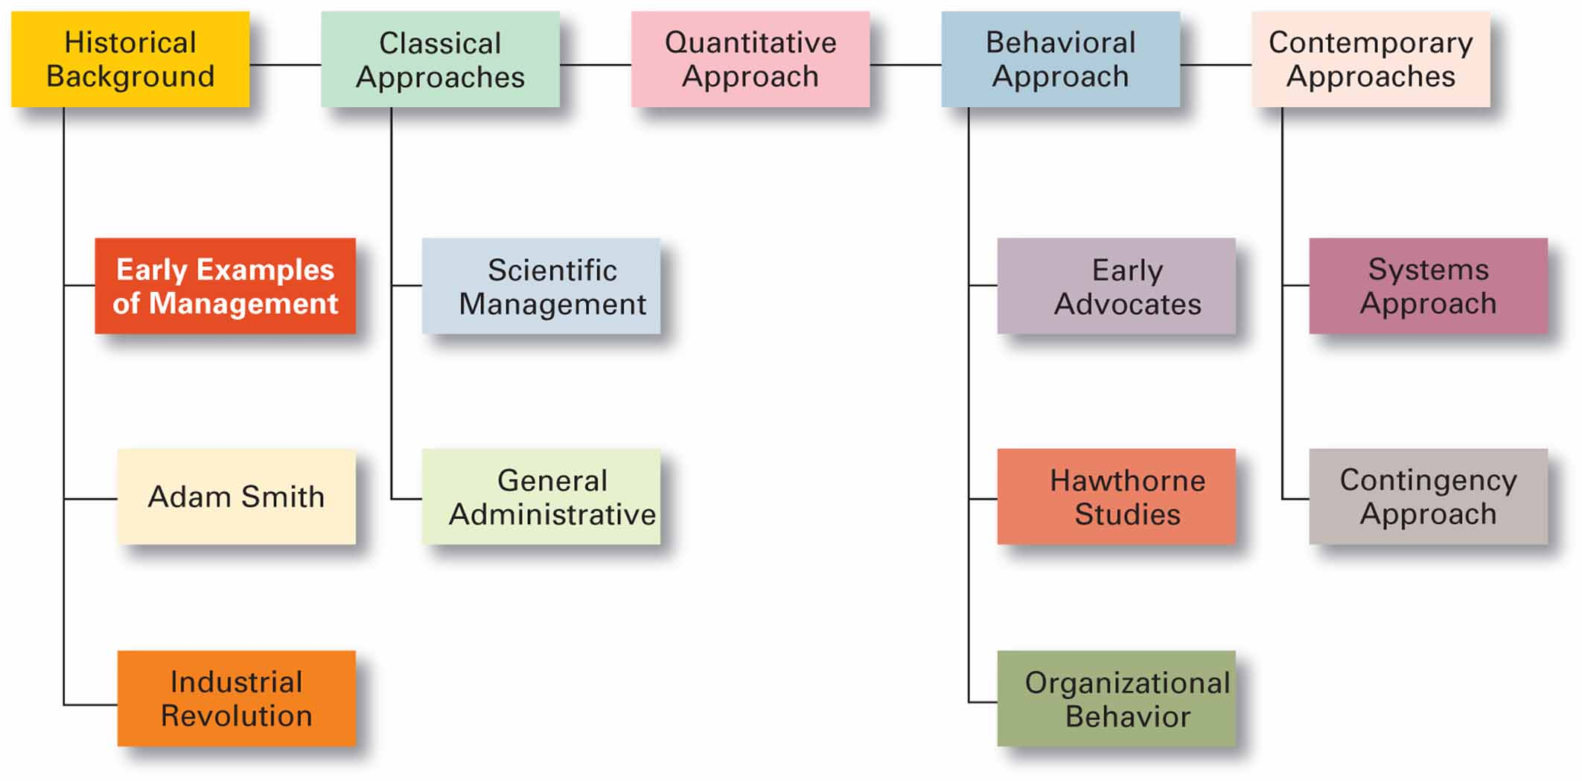
Exhibit 2–1 Major Approaches to Management

Slide 7

Major Approaches to Management
Classical
Quantitative
Behavioral
Contemporary

Slide 8
Scientific Management
Fredrick Winslow Taylor
  The “father” of scientific management
  Published Principles of Scientific Management (1911)
    The theory of scientific management
      Using scientific methods to define the “one best way” for a job to be done:
        Putting the right person on the job with the correct tools and equipment.
        Having a standardized method of doing the job.
        Providing an economic incentive to the worker.

Slide 9
Exhibit 2–2 Taylor’s Scientific Management Principles
Develop a science for each element of an individual’s work, which will replace the old rule-of-thumb method.
Scientifically select and then train, teach, and develop the worker.
Heartily cooperate with the workers so as to ensure that all work is done in accordance with the principles of the science that has been developed.
Divide work and responsibility almost equally between management and workers. Management takes over all work for which it is better fitted than the workers.

Slide 10
General Administrative Theory
Henri Fayol
  Believed that the practice of management was distinct from other organizational functions
  Developed principles of management that applied to all organizational situations
Max Weber
  Developed a theory of authority based on an ideal type of organization (bureaucracy)
    Emphasized rationality, predictability, impersonality, technical competence, and authoritarianism

Slide 11
Scientific Management (cont’d)
Frank and Lillian Gilbreth
  Focused on increasing worker productivity through the reduction of wasted motion
  Developed the microchronometer to time worker motions and optimize work performance
How Do Today’s Managers Use Scientific Management?
  Use time and motion studies to increase productivity
  Hire the best qualified employees
  Design incentive systems based on output

Slide 12
Exhibit 2–3 Fayol’s 14 Principles of
Management
Division of work
Authority
Discipline
Unity of command
Unity of direction
Subordination of individual interests to the general interest
Remuneration
Centralization
Scalar chain
Order
Equity
Stability of tenure of personnel
Initiative
Esprit de corps

Slide 13
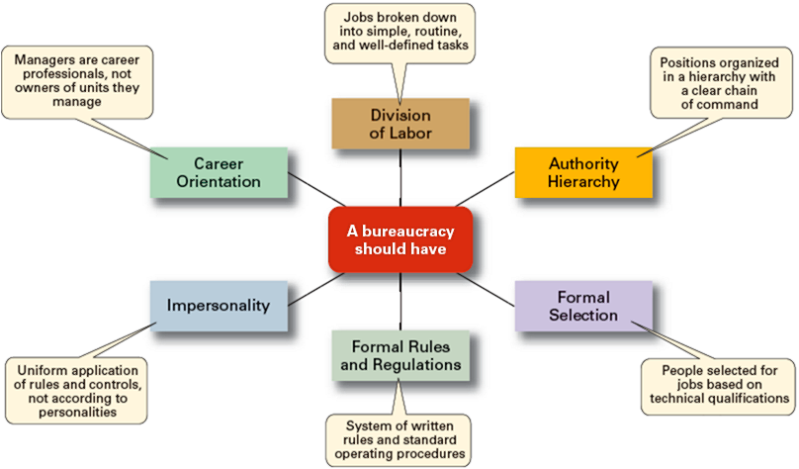
Exhibit 2–4 Weber’s Bureaucracy

Slide 14
Quantitative Approach to Management
Quantitative Approach
  Also called operations research or management science
  Evolved from mathematical and statistical methods developed to solve WWII military logistics and quality control problems
  Focuses on improving managerial decision making by applying:
    Statistics, optimization models, information models, and computer simulations

Slide 15
Exhibit 2–5 What Is Quality Management?
Intense focus on the customer
Concern for continual improvement
Process-focused
Improvement in the quality of everything
Accurate measurement
Empowerment of employees

Slide 16

Understanding Organizational Behavior
Organizational Behavior (OB)
  The study of the actions of people at work; people are the most important asset of an organization
Early OB Advocates
  Robert Owen
  Hugo Munsterberg
  Mary Parker Follett
  Chester Barnard

Slide 17
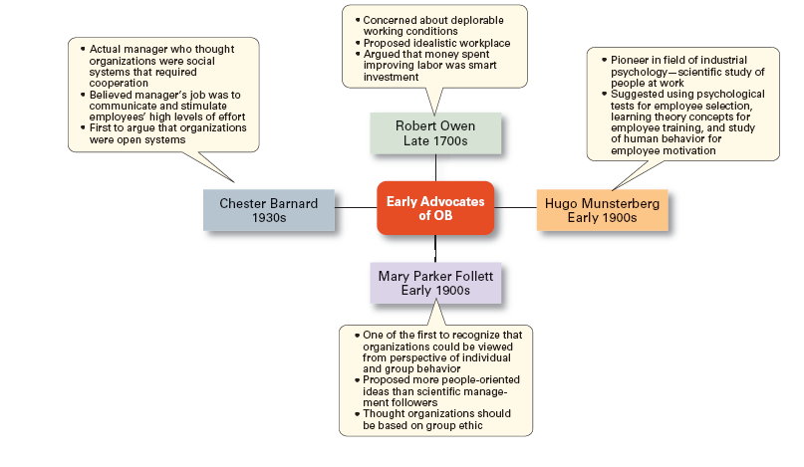
Exhibit 2–6 Early Advocates of OB

Slide 18
The Hawthorne Studies
A series of productivity experiments conducted at Western Electric from 1924 to 1932.
Experimental findings
  Productivity unexpectedly increased under imposed adverse working conditions.
  The effect of incentive plans was less than expected.
Research conclusion
  Social norms, group standards and attitudes more strongly influence individual output and work behavior than do monetary incentives.

Slide 19
The Systems Approach
System Defined
  A set of interrelated and interdependent parts arranged in a manner that produces a unified whole.
Basic Types of Systems
  Closed systems
    Are not influenced by and do not interact with their environment (all system input and output is internal).
  Open systems
    Dynamically interact to their environments by taking in inputs and transforming them into outputs that are distributed into their environments.

Slide 20
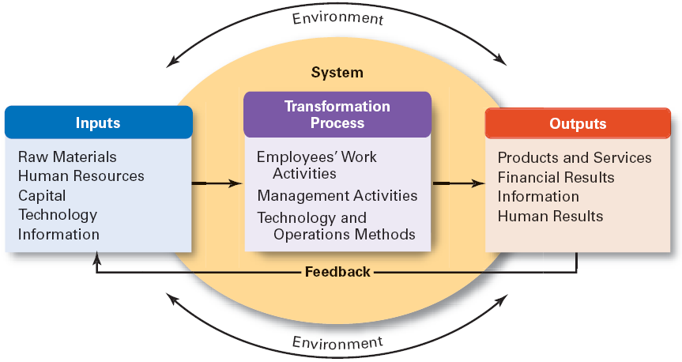
Exhibit 2–7 The Organization as an Open
System

Slide 21
Implications of the Systems Approach
Coordination of the organization’s parts is essential for proper functioning of the entire organization.
Decisions and actions taken in one area of the organization will have an effect in other areas of the organization.
Organizations are not self-contained and, therefore, must adapt to changes in their external environment.

Slide 22
The Contingency Approach
Contingency Approach Defined
  Also sometimes called the situational approach.
  There is no one universally applicable set of management principles (rules) by which to manage organizations.
  Organizations are individually different, face different situations (contingency variables), and require different ways of managing.

Slide 23
Exhibit 2–8 Popular Contingency Variables
Organization size
  As size increases, so do the problems of coordination.
Routineness of task technology
  Routine technologies require organizational structures, leadership styles, and control systems that differ from those required by customized or non-routine technologies.
Environmental uncertainty
  What works best in a stable and predictable environment may be totally inappropriate in a rapidly changing and unpredictable environment.
Individual differences
  Individuals differ in terms of their desire for growth, autonomy, tolerance of ambiguity, and expectations.

Slide 24
Terms to Know
division of labor (or job specialization)
Industrial Revolution
scientific management
therbligs
general administrative theory
principles of management
bureaucracy
quantitative approach
organizational behavior (OB)
Hawthorne Studies
system
closed systems
open systems
contingency approach

Slide 25

All rights reserved. No part of this publication may be reproduced, stored in a retrieval system, or transmitted, in any form or by any means, electronic, mechanical, photocopying, recording, or otherwise, without the prior written permission of the publisher. Printed in the United States of America.

